Slide 1

Ratings of drugs for certain conditions
Authors: Robert-Alexandru Delicostea & Andreea-Diana Ciocaianu

Slide 2
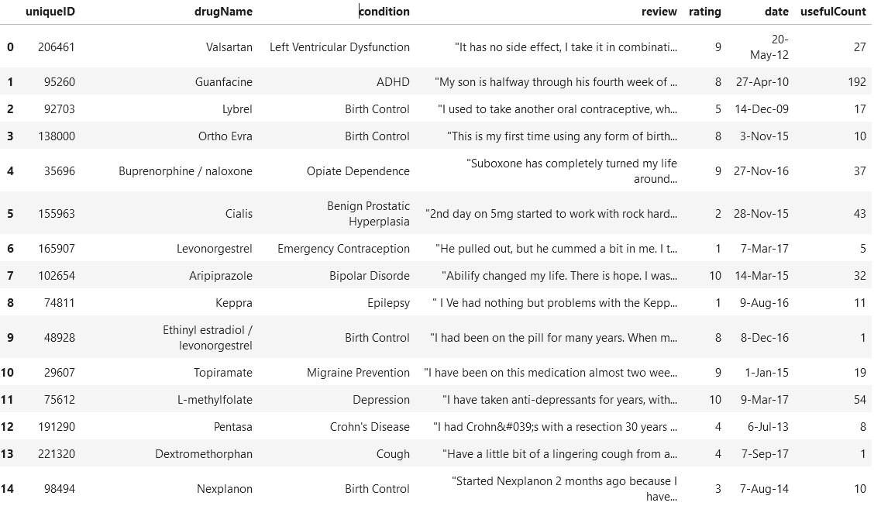
-The dataset – UCI ML Drug Reviews
Reviews on different kinds of drugs with the condition they were meant to treat rated based on a 10-star system according to the overall patient satisfaction

Slide 3
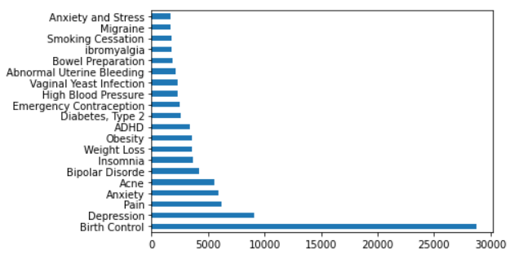
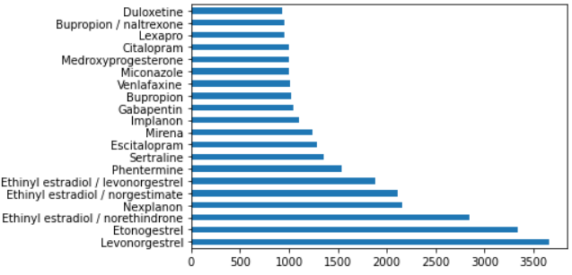
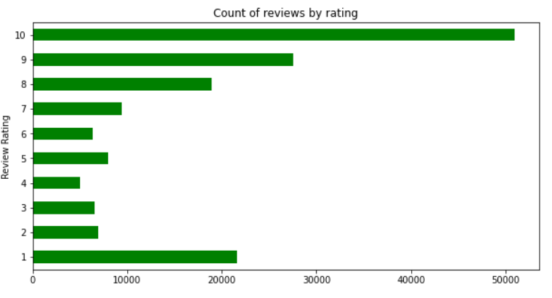
First-look analysis
Top 20 drugs
Top 20 conditions
Review distribution based on rating

Slide 4
Top 5 drugs used for top 3 conditions
Depression
Bupropion
Sertraline
Venlafaxine
Desvenlafaxine
Pristiq
Pain
Tramadol
Acetaminophen / hydrocodone
Oxycodone
Tapentadol
Acetaminophen / oxycodone
Birth control
Etonogestrel
Ethinyl estradiol / norethindrone
Nexplanon
Levonorgestrel
Ethinyl estradiol / norgestimate
Depression
Bupropion
Sertraline
Venlafaxine
Desvenlafaxine
Pristiq
Pain
Tramadol
Acetaminophen / hydrocodone
Oxycodone
Tapentadol
Acetaminophen / oxycodone

Slide 5
Top conditions treated by top 4 drugs
Levonorgestrel
Birth Control
Emergency Contraception
Abnormal Uterine Bleeding
Not Listed / Other
Etonogestrel
Birth Control
Endometriosis
Ethinyl
estradiol / norethindrone
Birth Control
Acne
Menstrual Disorders
Abnormal Uterine Bleeding
Nexplanon
Birth Control

Slide 6
About the ratings
New Feature
train["rating range"] = train['rating'].apply(lambda x: 'low' if x < 4 else 'middle' if x > 3 and x < 8 else 'high')

Slide 7
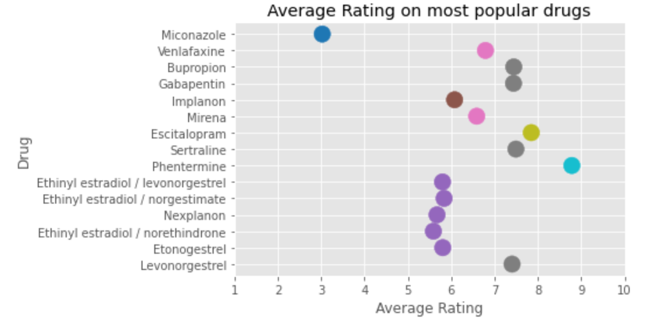
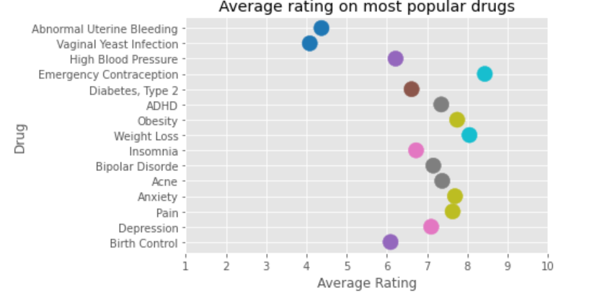
Average rating
For most popular drugs
For most popular conditions

Slide 8
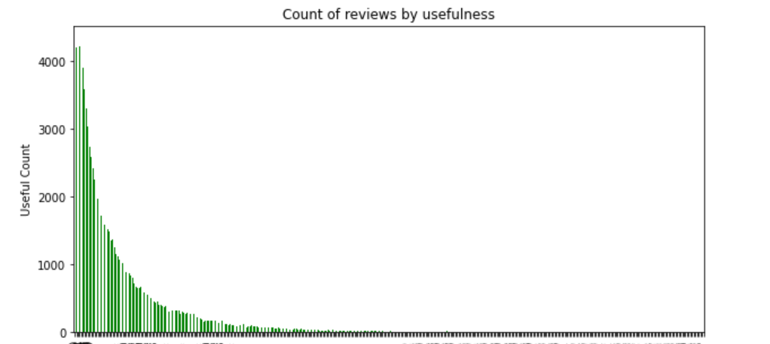
About the usefulness
New Feature
train['usefulCount range'] = train['usefulCount'].apply( lambda x: 'low' if x < 20 else 'upper low' if x > 20 and x < 40 else 'middle' if x > 40 and x < 100 else 'high')

Slide 9
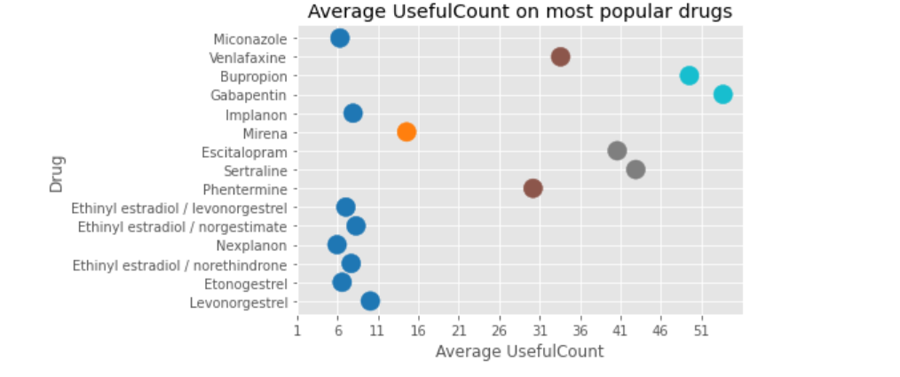
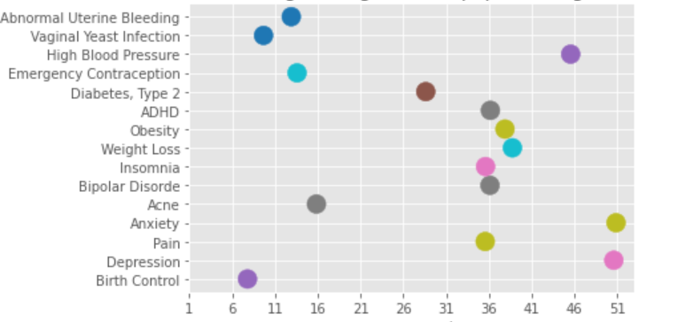
Average usefulness
For most popular drugs
For most popular conditions

Slide 10
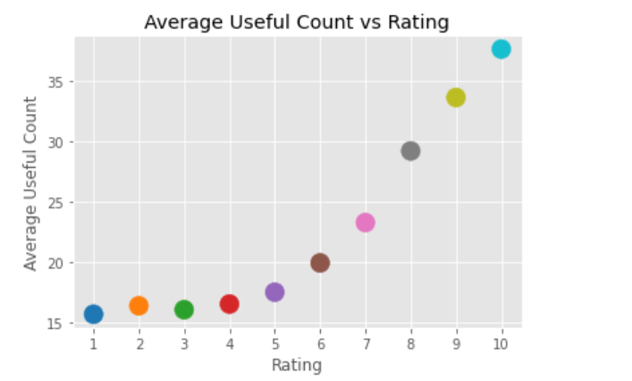
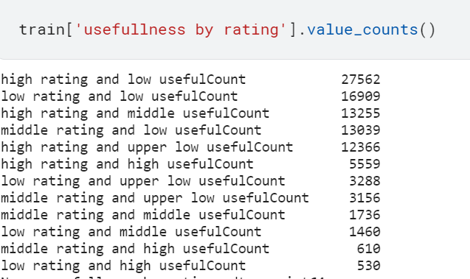
Rating & Usefulness
New Feature
The bigger the rating, the more useful the review is.

Slide 11
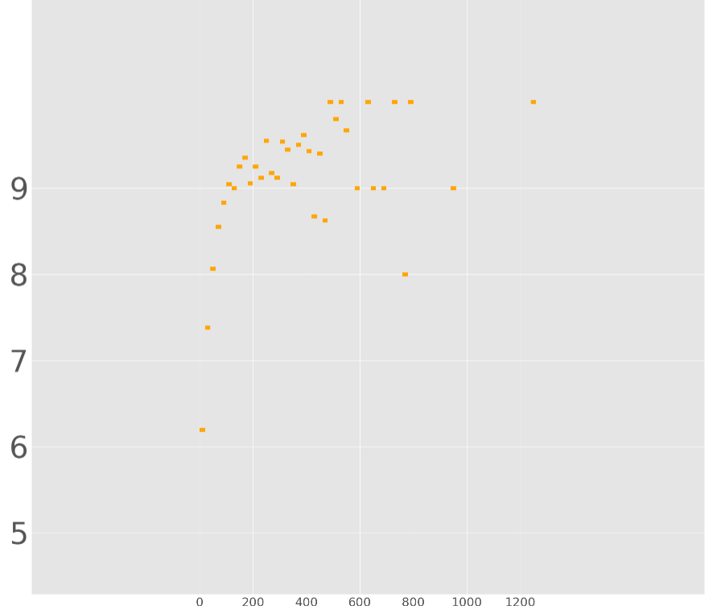
Average rating for ranges of usefulness
Majority of usefullCount are up to 120 with 4 ranges, 0-20, 20-40, 40-120, and more than 120.

Slide 12
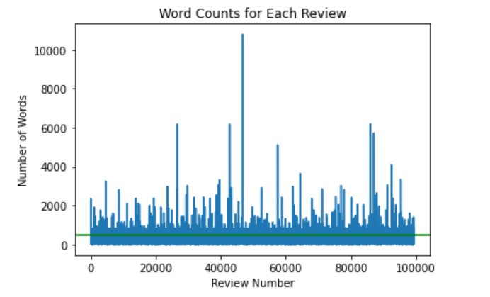
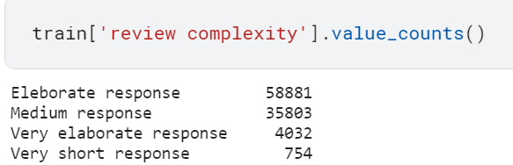
About the reviews
New Feature
Future work: Predict the ratings using sentiment-analysis methods on the reviews

Slide 13
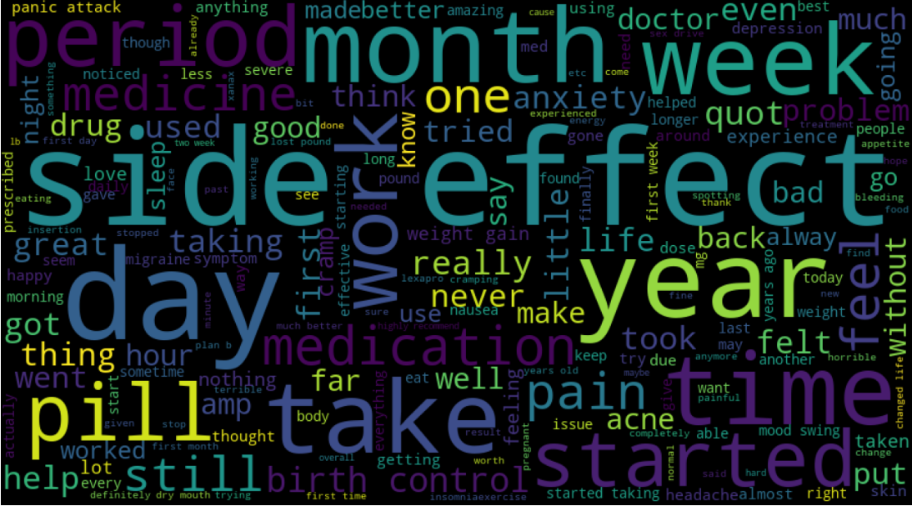
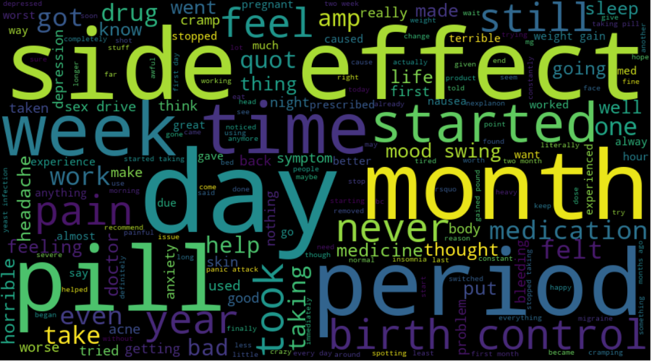
Common words
For highly rated reviews
For low rated reviews

Slide 14
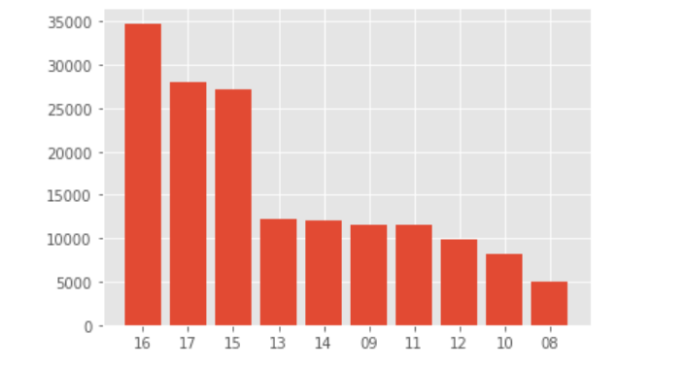
Count of reviews per year
New Feature
train["how current it is"] = train["year"].apply(lambda x: "current" if int(x) > 14 else "more distant" if int(x) <= 14 and int(x) >= 11 else "very distant")
Future Work: Consider the month to determine the season a drug was mostly used

Slide 15
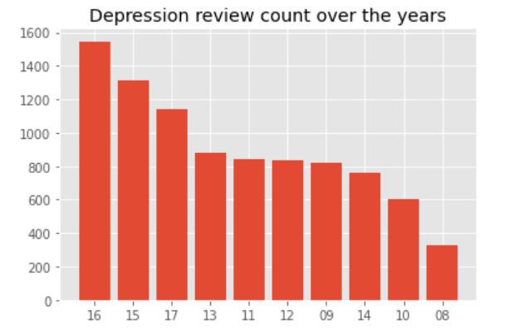
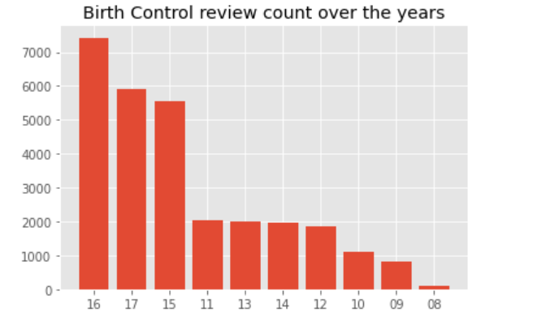
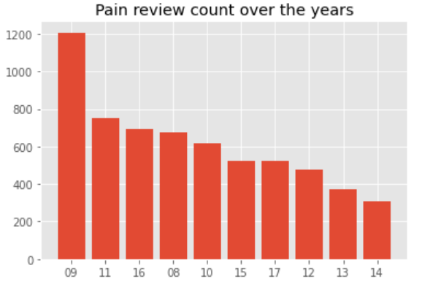
Count of reviews per year – Top 3 conditions-

Slide 16
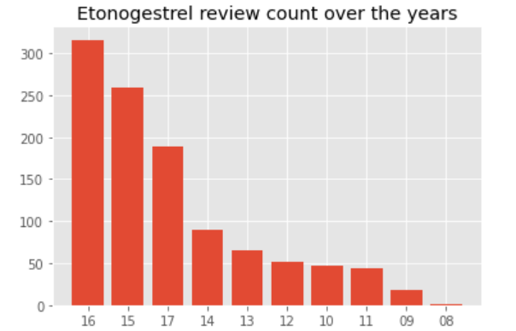
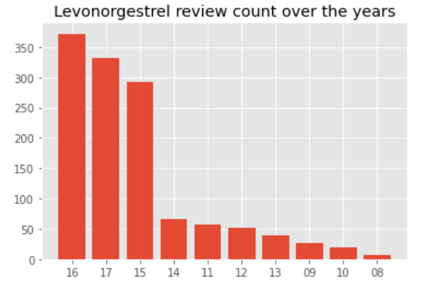
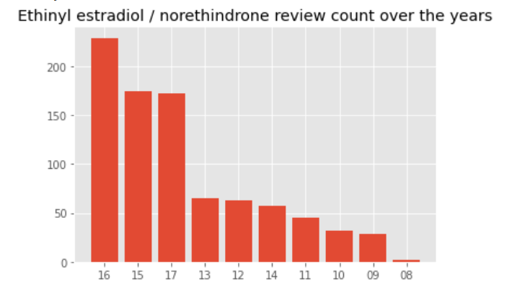
Count of reviews per year – Top 3 drugs-

Slide 17

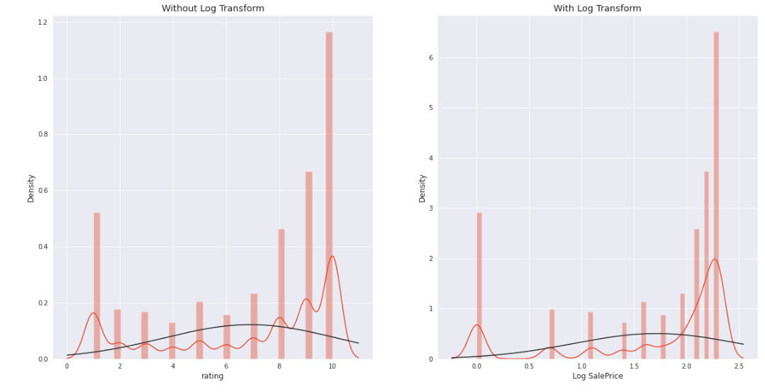
Balancing the dataset
Skewed feature

Slide 18
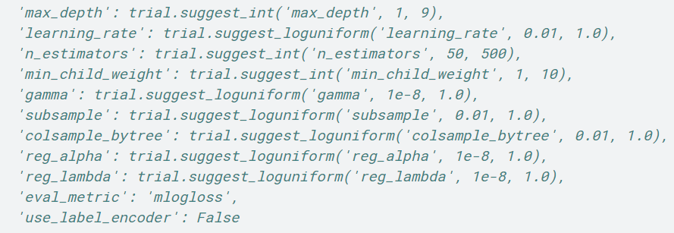
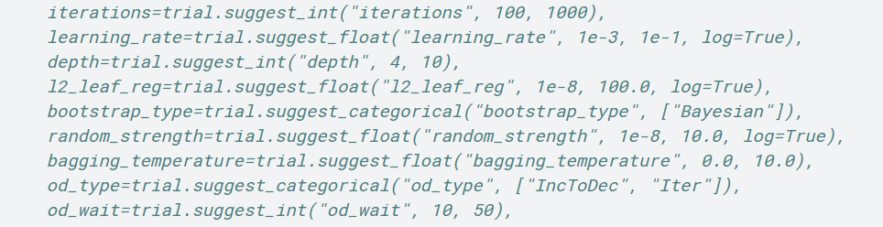
Hyper-parameter tuning
Initial split: train 80%, test 20%
Optuna optimizer – to find best parameters that compute the best accuracy
XGBoost
CatBoost
Future work: Random forest, Neural Networks, etc.

Slide 19
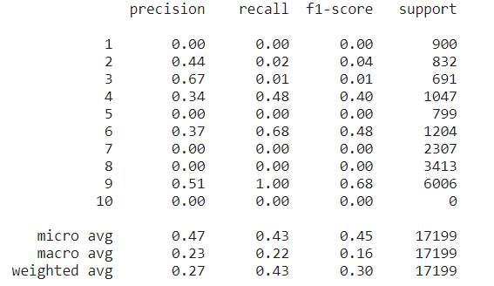
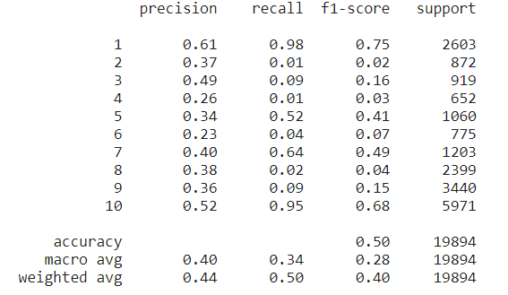
Classifications models and their results
XGBoost
CatBoost
Both models have an accuracy of approx. 50%, one reason being the lack of stratification the ratings present.

Slide 20
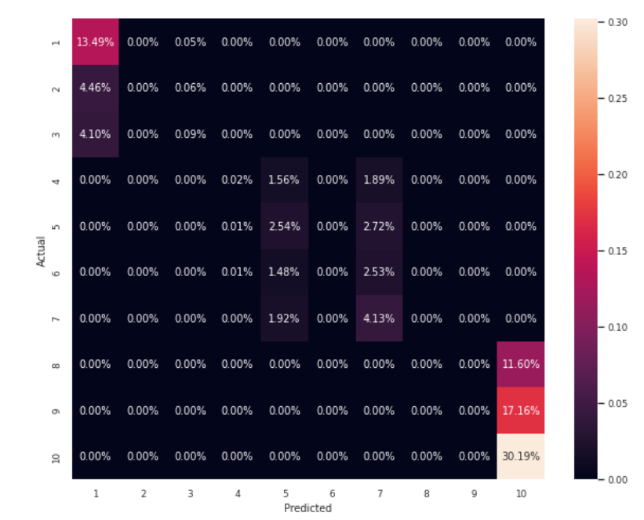
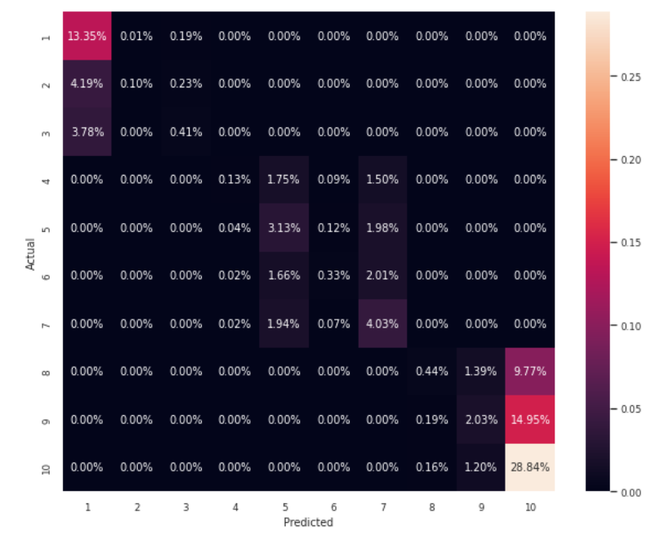
Classifications models and their results
XGBoost
CatBoost

Slide 21

Thank you for your attention

